Slide 1

Chapter 7 The Binary Search Tree ADT

Slide 2
Chapter 7: The Binary Search Tree ADT
7.1 – Trees
7.2 – Binary Search Trees
7.3 – The Binary Search Tree Interface
7.4 – The Implementation Level: Basics
7.5 – Iterative Versus Recursive Method Implementations
7.6 – The Implementation Level: Remaining Observers
7.7 – The Implementation Level: Transformers
7.8 – Binary Search Tree Performance
7.9 – Application: Word Frequency Counter
7.10 – Tree Variations

Slide 3
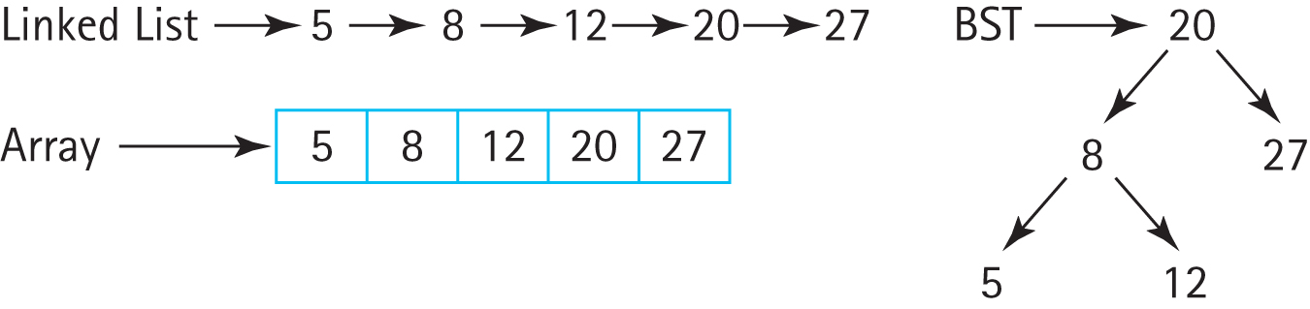
Binary Search Tree
When maintaining a sorted list
Linked List requires O(N) find location, O(1) insertion
Array requires O(log₂N) find location, O(N) insertion
Binary Search Tree, in general allows O(log₂N) find location , O(1) insertion

Slide 4
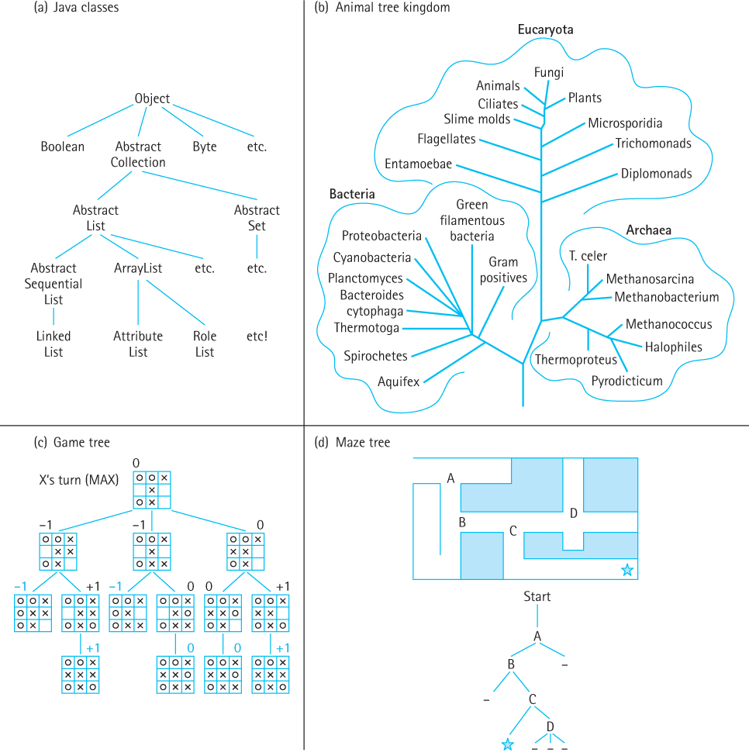
7.1 Trees
A tree is a nonlinear structure in which each node is capable of having many successor nodes, called children.
Trees are useful for representing lots of varied relationships among data items.

Slide 5
Definitions
Tree A structure with a unique starting node (the root), in which each node is capable of having multiple successor nodes (its children), and in which a unique path exists from the root to every other node.
Root The top node of a tree structure; a node with no parent
Parent node The predecessor node of a node is its parent
Subtree A node and all of its descendants form a subtree rooted at the node

Slide 6
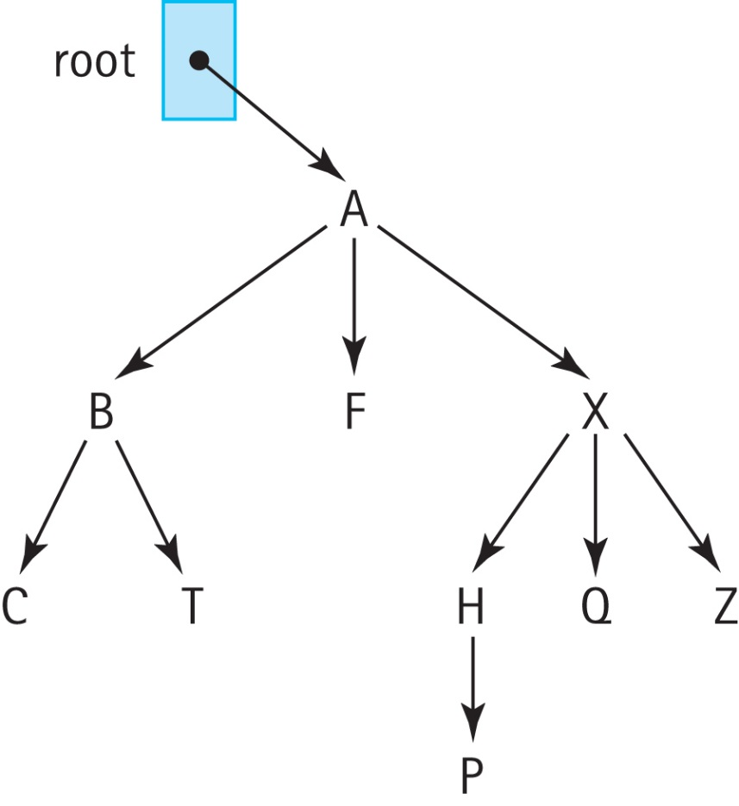
Examples
The root is A
The children of A are B, F, and X
The parent of Q is X
The leftmost subtree of X contains H and P

Slide 7
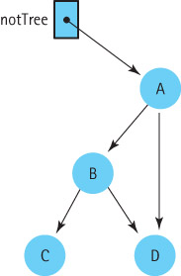
Not a Tree →
Required
A tree’s subtrees must be disjoint
There is a unique path from the root of a tree to any other node of the tree

Slide 8
Definitions
Ancestor A parent of a node, or a parent of an ancestor
Descendant A child of a node, or a child of a descendant
Leaf A node that has no children
Interior node A node that is not a leaf
Siblings Nodes with the same parent

Slide 9
Examples
The ancestors of P are H, X, and A
The descendants of X are H, Q, Z, and P
The leaf nodes are C, T, F, P, Q, and Z
The interior nodes are A, B, X
The siblings of B are F and X

Slide 10
Definitions
Level The level of a node is its distance from the root (the number of connections between itself and the root)
Height The maximum level of the tree

Slide 11
Examples
The level of A is 0
The level of P is 3
The height of the tree is 3

Slide 12
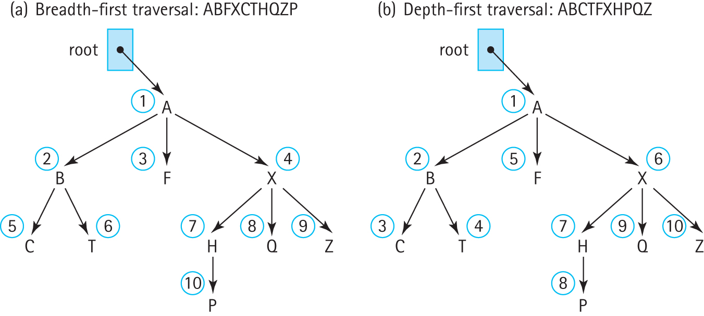
Breadth-First Traversal
Also called “level-order traversal”
A B F X C T H Q Z P

Slide 13

Breadth-First Traversal(root)
Instantiate a queue of nodes
if (root is not null)
{
queue.enqueue(root)
while (!queue.isEmpty())
{
node = queue.dequeue()
Visit node
Enqueue the children of node
(from left to right) into queue
}
}
Try It!

Slide 14
Depth-First Traversal
A B C T F X H P Q Z

Slide 15
Depth-First Traversal(root)
Instantiate a stack of nodes
if (root is not null)
{
stack.push(root)
while (!stack.isEmpty())
{
node = stack.top()
stack.pop()
Visit node
Push the children of node
(from right to left) onto queue
}
}
Try It!

Slide 16
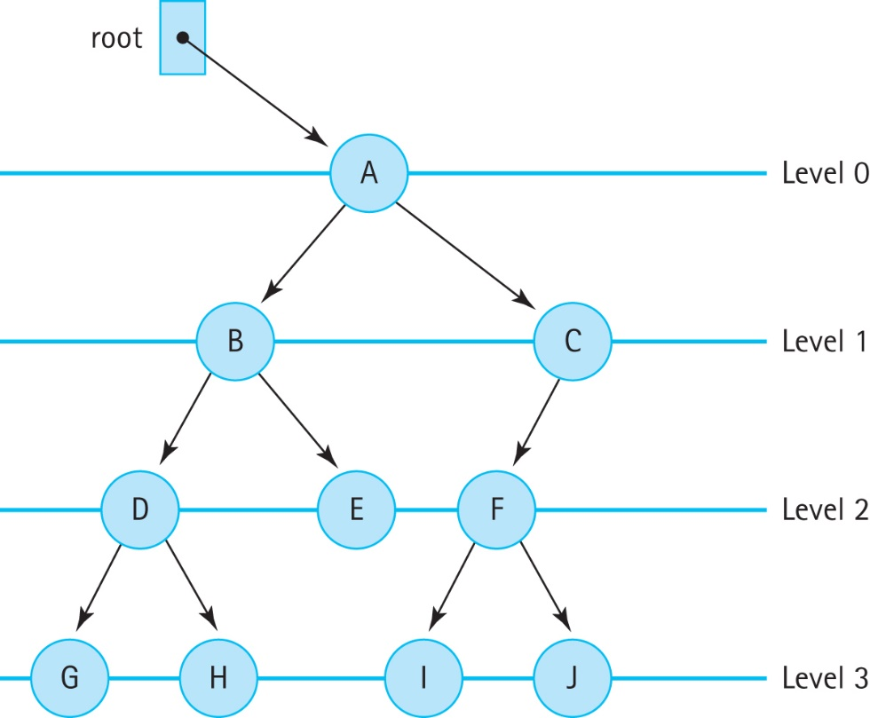
7.2 Binary Search Trees
Binary tree A tree in which each node is capable of having two child nodes, a left child node and a right child node
A Binary Tree

Slide 17
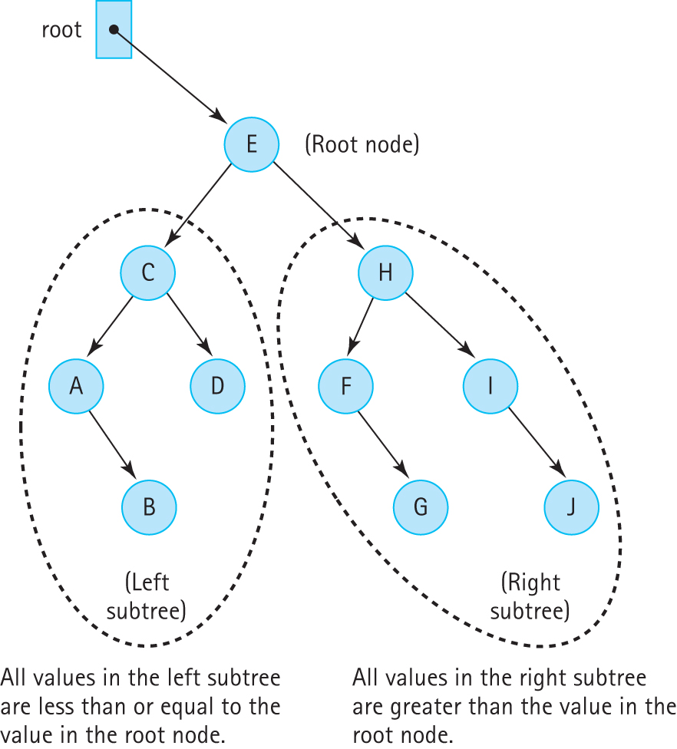
A Binary Search Tree
These trees facilitate
searching for an
element.

Slide 18
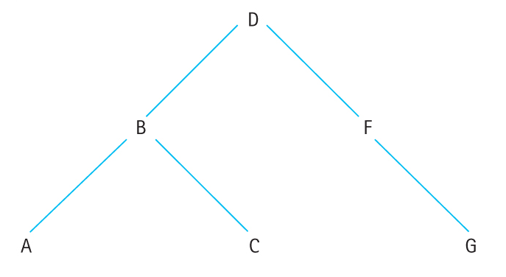
Binary search tree
A binary tree in which the key value in any node
is greater than or equal to the key value in its left child and any of its descendants (the nodes in the left subtree)
is less than the key value in its right child and any of its descendants (the nodes in the right subtree)
We call this the “binary search tree” property

Slide 19
Binary Tree Traversals
Preorder traversal: Visit the root, visit the left subtree, visit the right subtree:
D B A C F G
Inorder traversal: Visit the left subtree, visit the root, visit the right subtree:
A B C D F G
Postorder traversal: Visit the left subtree, visit the right subtree, visit the root:
A C B G F D

Slide 20
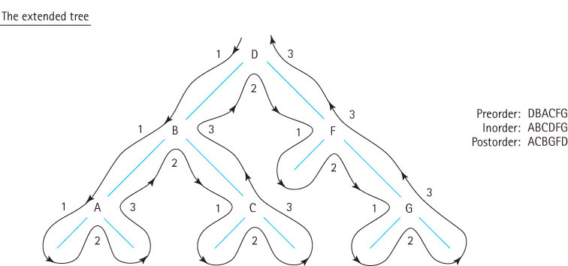
Visualizing Binary Tree Traversals

Slide 21
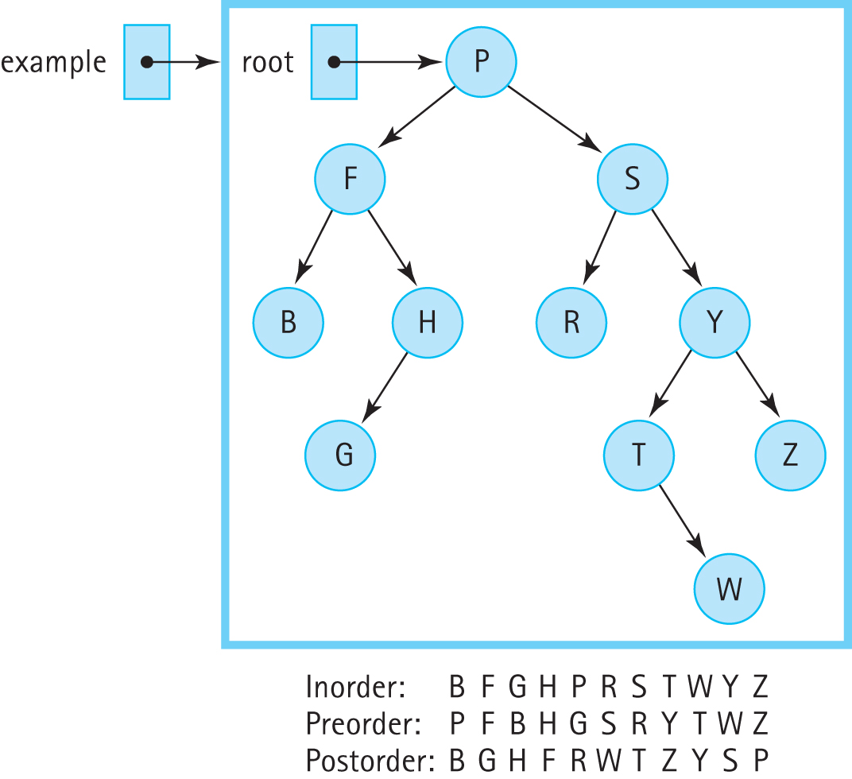
Three Binary Tree Traversals

Slide 22
7.3 – The Binary Search Tree Interface
Our binary search trees
are similar to the sorted lists of Chapter 6
implement this text’s CollectionInterface
implement the Java Library’s Iterable interface
are unbounded, allow duplicate elements, and disallow null elements
support max and min operations
support preorder, inorder, and postorder traversals

Slide 23
package ch07.trees;
import ch05.collections.CollectionInterface;
import java.util.Iterator;
public interface BSTInterface<T> extends CollectionInterface<T>,
Iterable<T>
{
// Used to specify traversal order.
public enum Traversal {Inorder, Preorder, Postorder};
T min();
// If this BST is empty, returns null;
// otherwise returns the smallest element of the tree.
T max();
// If this BST is empty, returns null;
// otherwise returns the largest element of the tree.
public Iterator<T> getIterator(Traversal orderType);
// Creates and returns an Iterator providing a traversal of a "snapshot“
// of the current tree in the order indicated by the argument.
}

Slide 24
Iteration
In addition to the getIterator method, a class that implements the BSTInterface must provide a separate iterator method, because BSTInterface extends Iterable.
This method should return an Iterator that provides iteration in the “natural” order of the tree elements.
For most applications this would be an inorder traversal, and we make that assumption in our implementation.

Slide 25
Iteration
We intend the iterators created and returned by getIterator and iterator to provide a snapshot of the tree as it exists at the time the iterator is requested.
They represent the state of the tree at that time and subsequent changes to the tree should not affect the results returned by the iterator’s hasNext and next methods.
Our iterators will throw an UnsupportedOperationException if remove is invoked.

Slide 26
Example Application
Instructors can review and demonstrate the application BSTExample found in the ch07.apps package
This application demonstrates the use of iterators with our binary search tree

Slide 27
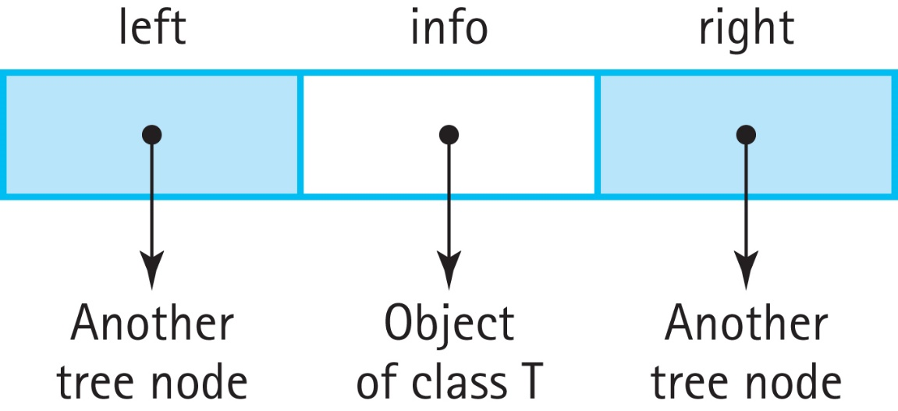
7.4 The Implementation Level: Basics
We define BSTNode.java in our support package to provide nodes for our binary search trees
Visually, a BSTNode object is:

Slide 28
BSTNode.java
instance variables:
private T info; // The info in a BST node
private BSTNode<T> left; // A link to the left child node
private BSTNode<T> right; // A link to the right child node
Constructor:
public BSTNode(T info)
{
this.info = info;
left = null;
right = null;
}
Plus it includes the standard setters and getters

Slide 29
Beginning of BinarySearchTree.java
package ch07.trees;
import java.util.*; // Iterator, Comparator
import ch04.queues.*;
import ch02.stacks.*;
import support.BSTNode;
public class BinarySearchTree<T> implements BSTInterface<T>
{
protected BSTNode<T> root; // reference to the root of this BST
protected Comparator<T> comp; // used for all comparisons
protected boolean found; // used by remove
. . .

Slide 30
The Constructors
public BinarySearchTree()
// Precondition: T implements Comparable
// Creates an empty BST object - uses the natural order of elements.
{
root = null;
comp = new Comparator<T>()
{
public int compare(T element1, T element2)
{
return ((Comparable)element1).compareTo(element2);
}
};
}
public BinarySearchTree(Comparator<T> comp)
// Creates an empty BST object - uses Comparator comp for order of elements.
{
root = null;
this.comp = comp;
}
. . .

Slide 31
Example Observer methods
public boolean isFull()
// Returns false; this link-based BST is never full.
{
return false;
}
public boolean isEmpty()
// Returns true if this BST is empty; otherwise, returns false.
{
return (root == null);
}
public T min()
// If this BST is empty, returns null;
// otherwise returns the smallest element of the tree.
{
if (isEmpty())
return null;
else
{
BSTNode<T> node = root;
while (node.getLeft() != null)
node = node.getLeft();
return node.getInfo();
}
}

Slide 32
7.5 Iterative versus Recursive Method Invocations
Trees are inherently recursive; a tree consists of subtrees
In this section we look at recursive and iterative approaches to the size method
We then discuss the benefits of recursion versus iteration for this problem

Slide 33
Recursive Approach
We create a public method, size, that calls a private recursive method, recSize and passes it a reference to the root of the tree.
public int size()
// Returns the number of elements in this BST.
{
return recSize(root);
}
We design the recSize method to return the number of nodes in the subtree referenced by the argument passed to it.
Note that the number of nodes in a tree is:
1 + number of nodes in left subtree + number of nodes in right subtree

Slide 34
recSize Algorithm Version 1
recSize(node): returns int
if (node.getLeft( ) is null) AND (node.getRight( ) is null)
return 1
else
return 1 + recSize(node.getLeft( )) + recSize(node.getRight( ))
The corresponding method would crash when we try to access node.getLeft when node is null.

Slide 35
recSize Algorithm Version 2
recSize(node): returns int Version 2
if (node is null)
return 0
else
if (node.getLeft() is null) AND (node.getRight() is null)
return 1
else
return 1 + recSize(node.getLeft()) + recSize(node.getRight())
Works, but can be simplified. There is no need to make the leaf node a special case – it would also be handled properly by the final else clause

Slide 36
recSize Algorithm Version 3
recSize(node): returns int Version 3
if node is null
return 0
else
return 1 + recSize(node.getLeft( )) + recSize(node.getRight( ))
Works and is “simple”.
This example illustrates two important points about recursion with trees:
always check for the empty tree first
leaf nodes do not need to be treated as separate cases.

Slide 37
The recSize Code
private int recSize(BSTNode<T> node)
// Returns the number of elements in subtree rooted at node.
{
if (node == null)
return 0;
else
return 1 + recSize(node.getLeft()) + recSize(node.getRight());
}

Slide 38
Iterative Version
We use a stack to hold nodes we have encountered but not yet processed
We must be careful that we process each node in the tree exactly once. We follow these rules:
Process a node immediately after removing it from the stack.
Do not process nodes at any other time.
Once a node is removed from the stack, do not push it back onto the stack.

Slide 39
Code for the iterative approach
public int size()
// Returns the number of elements in this BST.
{
int count = 0;
if (root != null)
{
LinkedStack<BSTNode<T>> nodeStack = new LinkedStack<BSTNode<T>> ();
BSTNode<T> currNode;
nodeStack.push(root);
while (!nodeStack.isEmpty())
{
currNode = nodeStack.top();
nodeStack.pop();
count++;
if (currNode.getLeft() != null)
nodeStack.push(currNode.getLeft());
if (currNode.getRight() != null)
nodeStack.push(currNode.getRight());
}
}
return count;
}

Slide 40
Recursion or Iteration?
Is the depth of recursion relatively shallow? Yes
Is the recursive solution shorter or clearer than the nonrecursive version? Yes
Is the recursive version much less efficient than the nonrecursive version? No
This is a good use of recursion.

Slide 41
7.6 The Implementation Level: Remaining Operations
In this section, we use recursion to implement the remaining Binary Search Tree operations
contains
get
add
remove
iterator
getIterator

Slide 42
The contains operation
We implement contains using a private recursive method called recContains which
is passed the target we are searching for and a node representing the root of the subtree in which to search
has two base cases
if node is null returns false
if node contains target returns true
has two recursive cases
one searches the left subtree of node
one searches the right subtree of node

Slide 43
The contains method
public boolean contains (T target)
// Returns true if this BST contains a node with info i such that
// comp.compare(target, i) == 0; otherwise, returns false.
{
return recContains(target, root);
}
private boolean recContains(T target, BSTNode<T> node)
// Returns true if the subtree rooted at node contains info i such that
// comp.compare(target, i) == 0; otherwise, returns false.
{
if (node == null)
return false; // target is not found
else if (comp.compare(target, node.getInfo()) < 0)
return recContains(target, node.getLeft()); // Search left subtree
else if (comp.compare(target, node.getInfo()) > 0)
return recContains(target, node.getRight()); // Search right subtree
else
return true; // target is found
}

Slide 44
The get method is similar
public T get(T target)
// Returns info i from node of this BST where comp.compare(target, i) == 0;
// if no such node exists, returns null.
{
return recGet(target, root);
}
private T recGet(T target, BSTNode<T> node)
// Returns info i from the subtree rooted at node such that
// comp.compare(target, i) == 0; if no such info exists, returns null.
{
if (node == null)
return null; // target is not found
else if (comp.compare(target, node.getInfo()) < 0)
return recGet(target, node.getLeft()); // get from left subtree
else
if (comp.compare(target, node.getInfo()) > 0)
return recGet(target, node.getRight()); // get from right subtree
else
return node.getInfo(); // target is found
}

Slide 45
Iteration: Review of Traversal Definitions
Preorder traversal: Visit the root, visit the left subtree, visit the right subtree
Inorder traversal: Visit the left subtree, visit the root, visit the right subtree
Postorder traversal: Visit the left subtree, visit the right subtree, visit the root

Slide 46
the getIterator method
client passes getIterator an argument indicating one of the three traversal orders
getIterator creates the appropriate iterator and returns it by traversing the tree in the desired order and building a queue of T
It then creates an iterator using the anonymous inner class approach
returned iterator represents a snapshot of the tree at the time getIterator is invoked and does not support remove

Slide 47
public Iterator<T> getIterator(BSTInterface.Traversal orderType)
{
final LinkedQueue<T> infoQueue = new LinkedQueue<T>();
if (orderType == BSTInterface.Traversal.Preorder)
preOrder(root, infoQueue);
else if (orderType == BSTInterface.Traversal.Inorder)
inOrder(root, infoQueue);
else if (orderType == BSTInterface.Traversal.Postorder)
postOrder(root, infoQueue);
return new Iterator<T>()
{
public boolean hasNext()
{
return !infoQueue.isEmpty();
}
public T next()
{
if (!hasNext())
throw new IndexOutOfBoundsException("illegal invocation of next …
return infoQueue.dequeue();
}
public void remove()
{
throw new UnsupportedOperationException("Unsupported remove attempted …
}
};
}

Slide 48
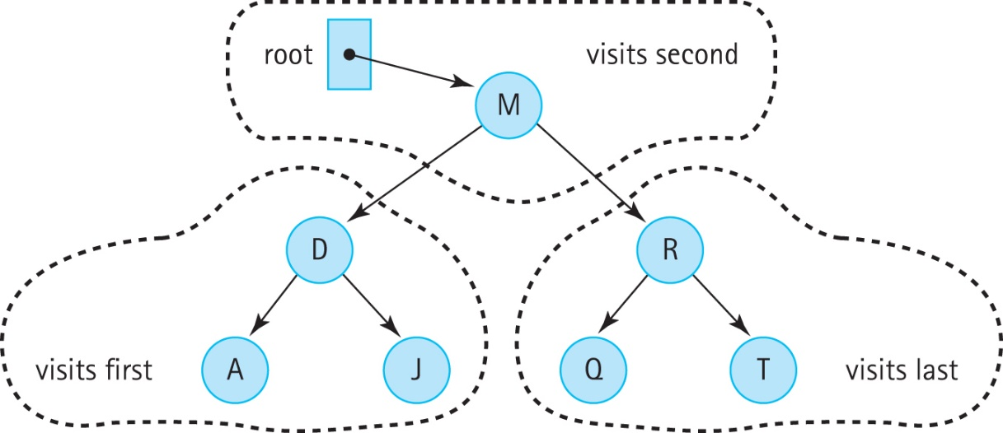
InOrder traversal
private void inOrder(BSTNode<T> node, LinkedQueue<T> q)
// Enqueues the elements from the subtree rooted at node into q in inOrder.
{ if (node != null)
{
inOrder(node.getLeft(), q);
q.enqueue(node.getInfo());
inOrder(node.getRight(), q);
} }

Slide 49
preOrder and postorder traversals
private void preOrder(BSTNode<T> node, LinkedQueue<T> q)
{
if (node != null)
{
q.enqueue(node.getInfo());
preOrder(node.getLeft(), q);
preOrder(node.getRight(), q);
}
}
private void postOrder(BSTNode<T> node, LinkedQueue<T> q)
{
if (node != null)
{
postOrder(node.getLeft(), q);
postOrder(node.getRight(), q);
q.enqueue(node.getInfo());
}
}

Slide 50
7.7 The Implementation Level: Transformers
To complete our implementation of the Binary Search Tree ADT we need to create the transformer methods add and remove.
These are the most complex operations.
We use a similar approach as used in the subsection “Transforming a Linked List” in Section 3.4, “Recursive Processing of Linked Lists”

Slide 51
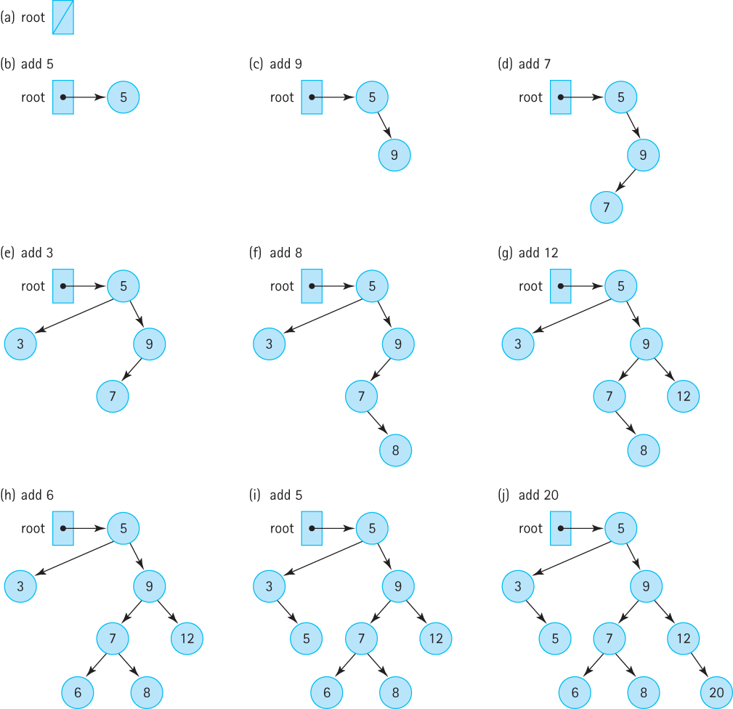
The add operation
A new node is always inserted into its appropriate position in the tree as a leaf

Slide 52
The add operation
The add method invokes the recursive method, recAdd, and passes it the element to be added plus a reference to the root of the tree.
public boolean add (T element)
// Adds element to this BST. The tree retains its BST property.
{
root = recAdd(element, root);
return true;
}
The call to recAdd returns a BSTNode. It returns a reference to the new tree, that is, to the tree that includes element. The statement
root = recAdd(element, root);
can be interpreted as “Set the reference of the root of this tree to the root of the tree that is generated when element is added to this tree.”

Slide 53
The add method
private BSTNode<T> recAdd(T element, BSTNode<T> node)
// Adds element to tree rooted at node; tree retains its BST property.
{
if (node == null)
// Addition place found
node = new BSTNode<T>(element);
else if (element.compareTo(node.getInfo()) <= 0)
node.setLeft(recAdd(element, node.getLeft())); // Add in left subtree
else
node.setRight(recAdd(element, node.getRight())); // Add in right subtree
return tree;
}
public boolean add (T element)
// Adds element to this BST. The tree retains its BST property.
{
root = recAdd(element, root);
return true;
}

Slide 54
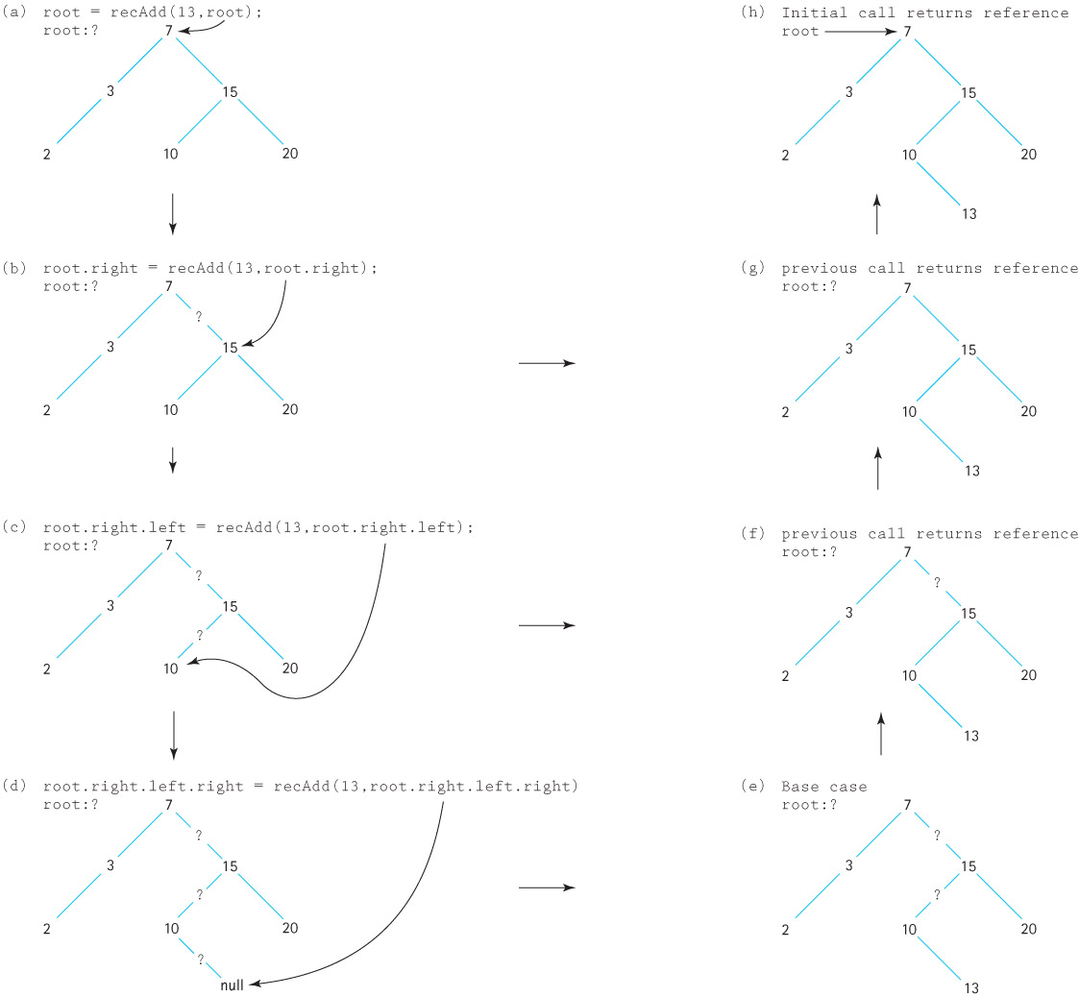

Slide 55
The remove Operation
The most complicated of the binary search tree operations.
We must ensure when we remove an element we maintain the binary search tree property.

Slide 56
The code for remove:
The set up for the remove operation is the same as that for the add operation.
The private recRemove method is invoked from the public remove method with arguments equal to the target element to be removed and the root of the tree to remove it from.
The recursive method returns a reference to the revised tree
The remove method returns the boolean value stored in found, indicating the result of the remove operation.
public boolean remove (T target)
// Removes a node with info i from tree such that
// comp.compare(target,i) == 0 and returns true;
// if no such node exists, returns false.
{
root = recRemove(target, root);
return found;
}

Slide 57
The recRemove method
private BSTNode<T> recRemove(T target, BSTNode<T> node)
// Removes element with info i from tree rooted at node such that
// comp.compare(target, i) == 0 and returns true;
// if no such node exists, returns false.
{
if (node == null)
found = false;
else if (comp.compare(target, node.getInfo()) < 0)
node.setLeft(recRemove(target, node.getLeft()));
else if (comp.compare(target, node.getInfo()) > 0)
node.setRight(recRemove(target, node.getRight()));
else
{
node = removeNode(node);
found = true;
}
return node;
}

Slide 58
Three cases for the removeNode operation
Removing a leaf (no children): removing a leaf is simply a matter of setting the appropriate link of its parent to null.
Removing a node with only one child: make the reference from the parent skip over the removed node and point instead to the child of the node we intend to remove
Removing a node with two children: replaces the node’s info with the info from another node in the tree so that the search property is retained - then remove this other node

Slide 59
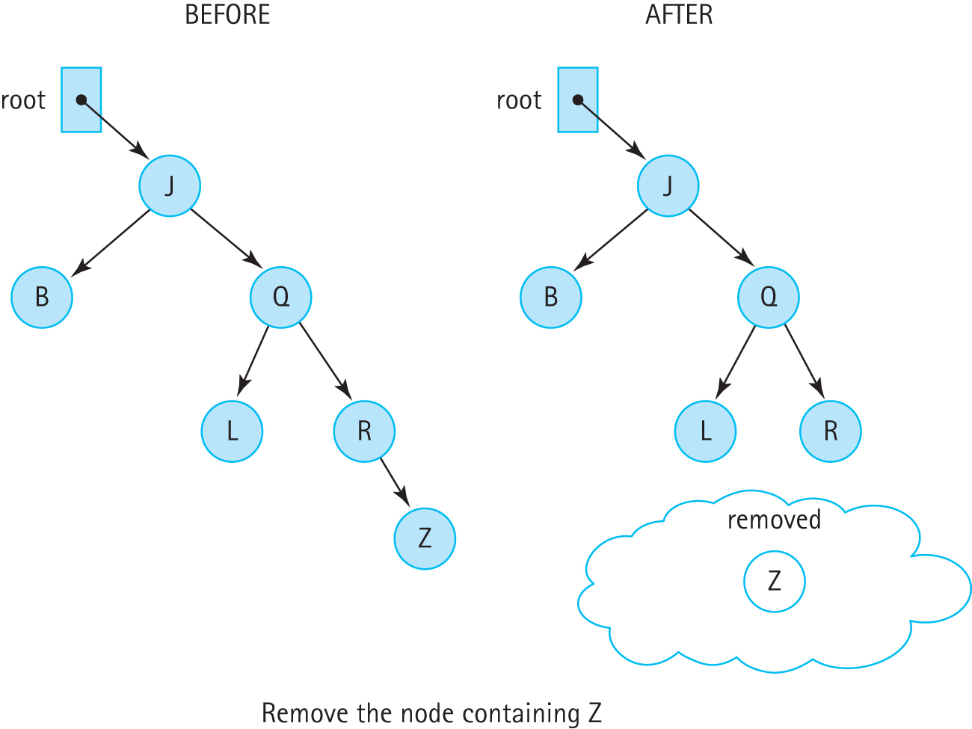
Removing a Leaf Node

Slide 60
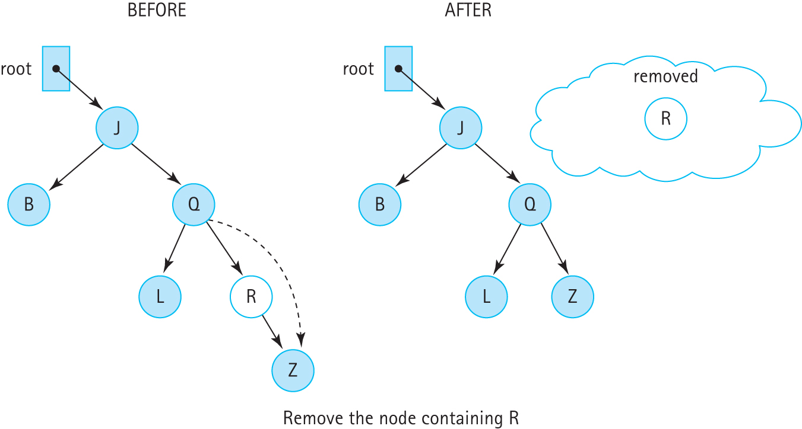
Removing a node with one child

Slide 61
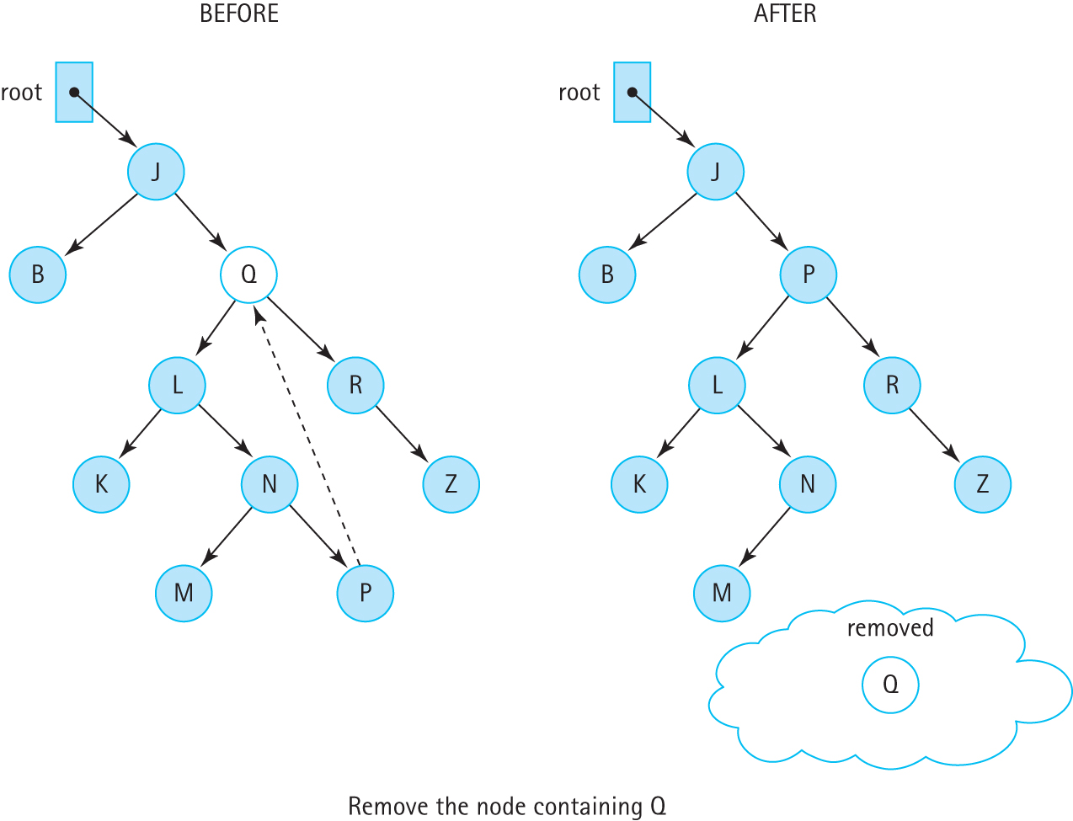
Removing a Node With Two Children

Slide 62
The Remove Node Algorithm
removeNode (node): returns BSTNode
if (node.getLeft( ) is null) AND (node.getRight( ) is null)
return null
else if node.getLeft( ) is null
return node.getRight( )
else if node.getRight( ) is null
return node.getLeft( )
else
Find predecessor
node.setInfo(predecessor.getInfo( ))
node.setLeft(recRemove(predecessor.getInfo( ), node.getLeft( )))
return node
Note: We can remove one of the tests if we notice that the action taken when the left child reference is null also takes care of the case in which both child references are null. When the left child reference is null, the right child reference is returned. If the right child reference is also null, then null is returned, which is what we want if they are both null.

Slide 63
The removeNode method
private BSTNode<T> removeNode(BSTNode<T> node)
// Removes the information at node from the tree.
{
T data;
if (node.getLeft() == null)
return node.getRight();
else if (node.getRight() == null)
return node.getLeft();
else
{
data = getPredecessor(node.getLeft());
node.setInfo(data);
node.setLeft(recRemove(data, node.getLeft()));
return node;
}
}

Slide 64
The getPredecessor method
The logical predecessor is the maximum value in node’s left subtree.
The maximum value in a binary search tree is in its rightmost node.
Therefore, given node’s left subtree, we just keep moving right until the right child is null.
When this occurs, we return the info reference of the node.
private T getPredecessor(BSTNode<T> subtree)
// Returns the information held in the rightmost node of subtree
{
BSTNode temp = subtree;
while (temp.getRight() != null)
temp = temp.getRight();
return temp.getInfo();
}

Slide 65
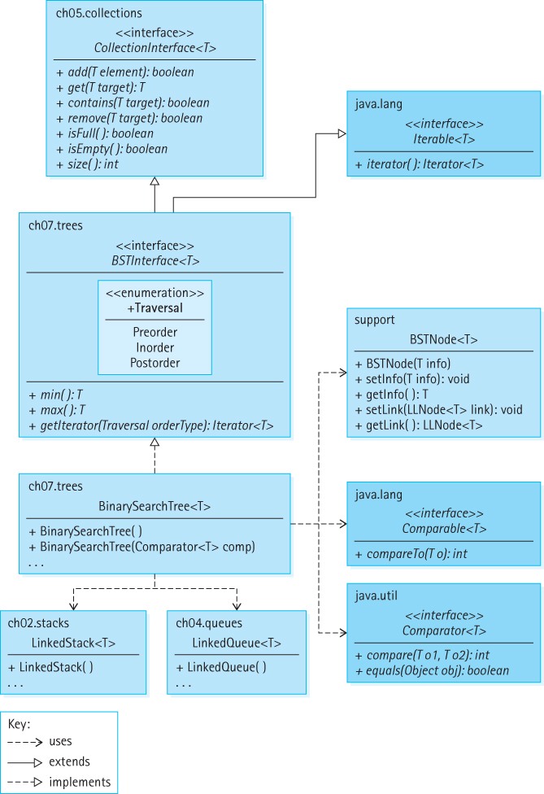
Our Binary Search Tree Architecture

Slide 66
7.8 Binary Search Tree Performance
A binary search tree is an appropriate structure for many of the same applications discussed previously in conjunction with sorted lists.
Similar to a sorted array-based list, it can be searched quickly, using a binary search.
Similar to a linked list, it allows insertions and removals without having to move large amounts of data.
There is a space cost - the binary search tree, with its extra reference in each node, takes up more memory space than a singly linked list.

Slide 67
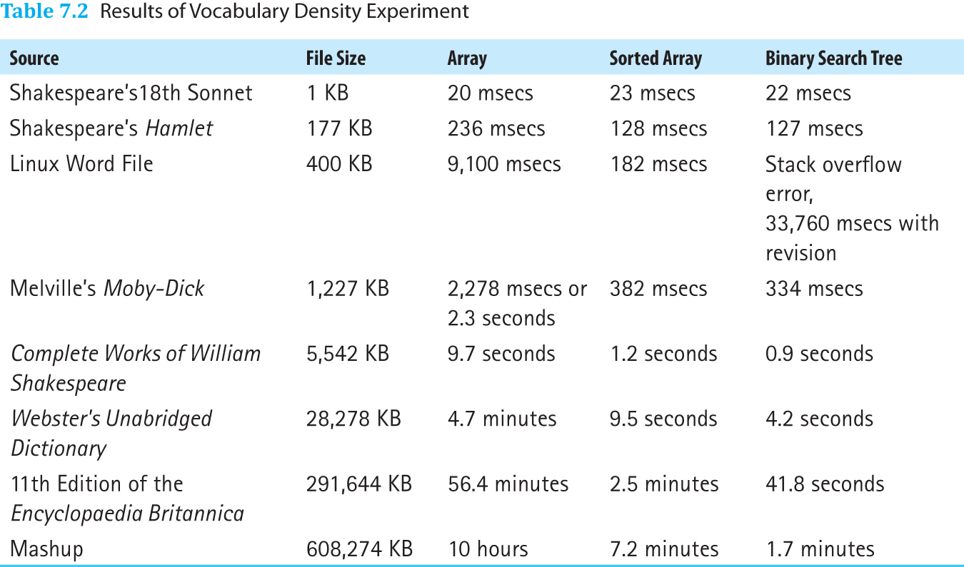
Text Analysis Experiment Revisited

Slide 68
Text Analysis Experiment Revisited
Due to operation complexity, performance gains from the binary search tree are only clearly evident as the size of the file increases.
The table also reveals a serious issue when the binary search tree structure is used for the Linux Word file. The application bombs—it stops executing and reports a “Stack overflow error.”
The problem is that the underlying tree is completely skewed.

Slide 69
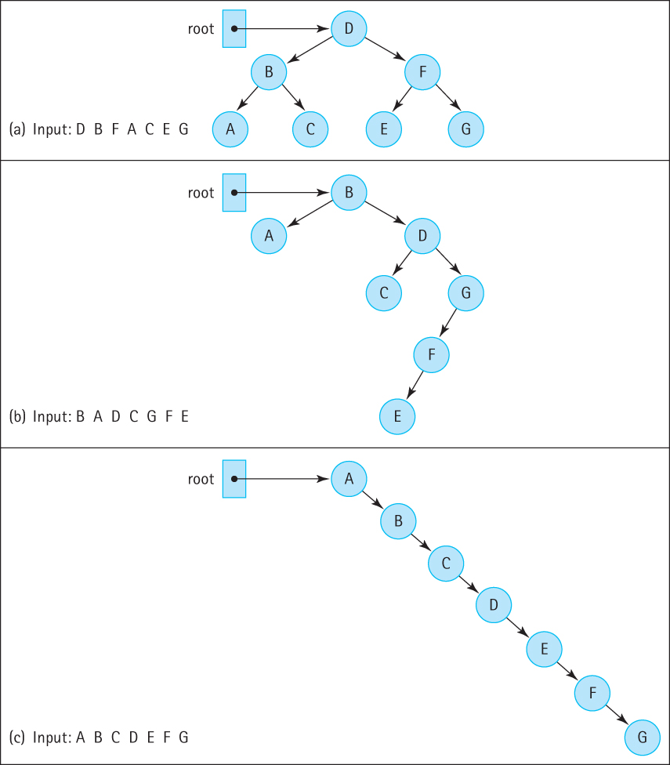
Insertion Order and Tree Shape
Linux Word
File is like this →

Slide 70
Balancing a Binary Search Tree
A beneficial addition to our Binary Search Tree ADT operations is a balance operation
The specification of the operation is:
public balance();
// Restructures this BST to be optimally balanced
It is up to the client program to use the balance method appropriately

Slide 71
Our Approach
Basic algorithm:
Save the tree information in an array
Insert the information from the array back into the tree
The structure of the new tree depends on the order that we save the information into the array, or the order in which we insert the information back into the tree, or both
We save the information “in order” so that the array is sorted

Slide 72
To Ensure a Balanced Tree
Even out as much as possible, the number of descendants in each node’s left and right subtrees
First insert the “middle” item of the inOrder array
Then insert the left half of the array using the same approach
Then insert the right half of the array using the same approach

Slide 73
Our Balance Tree Algorithm
Balance
Iterator iter = tree.getIterator(Inorder )
int index = 0
while (iter.hasnext())
array[index] = iter.next( )
index++
tree = new BinarySearchTree()
tree.InsertTree(0, index - 1)
InsertTree(low, high)
if (low == high) // Base case 1
tree.add(array[low])
else if ((low + 1) == high) // Base case 2
tree.add(array[low])
tree.add(array[high])
else
mid = (low + high) / 2
tree.add(array[mid])
tree.InsertTree(low, mid – 1)
tree.InsertTree(mid + 1, high)

Slide 74
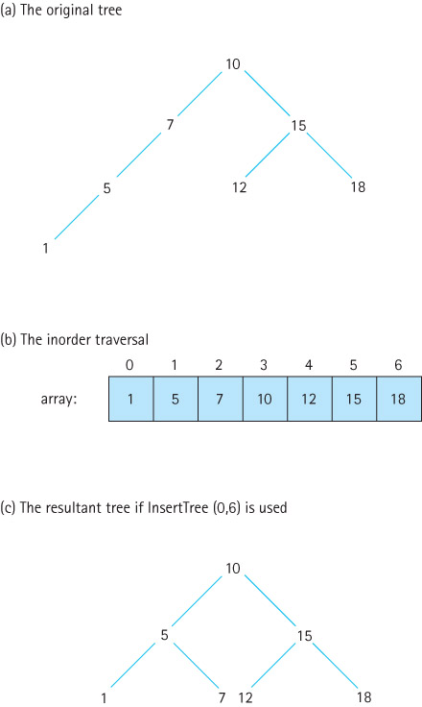
Using recursive insertTree

Slide 75
7.9 Application: Word Frequency Counter
In this section we develop a word frequency counter that uses our binary search tree
Read a text file and generate an alphabetical listing of the unique words, along with a count of how many times each word occurs
We allow users to specify a minimum word size and a minimum frequency count
Present a few summary statistics

Slide 76
The WordFreq Class
package support;
import java.text.DecimalFormat;
public class WordFreq implements Comparable<WordFreq>
{
private String word; private int freq;
DecimalFormat fmt = new DecimalFormat("00000");
public WordFreq(String newWord)
{
word = newWord; freq = 0;
}
public String getWordIs(){return word;}
public int getFreq(){return freq;}
public void inc() { freq++; }
public int compareTo(WordFreq other)
{
return this.word.compareTo(other.word);
}
public String toString()
{
return(fmt.format(freq) + " " + word);
}
}

Slide 77
The Application
Scans the input file for words, and after reading a word, it checks to see if a match is already in the tree, and if not it inserts a WordFreq object that holds the word and a frequency count of 1
If the word is already in the tree, increment the frequency associated with the word

Slide 78
Algorithm to process a word
wordToTry = new WordFreq(word)
wordInTree = tree.get(wordToTry)
if (wordInTree != null)
wordInTree.inc()
else
wordToTry.inc() // to set its frequency to 1
tree.add(wordToTry);

Slide 79
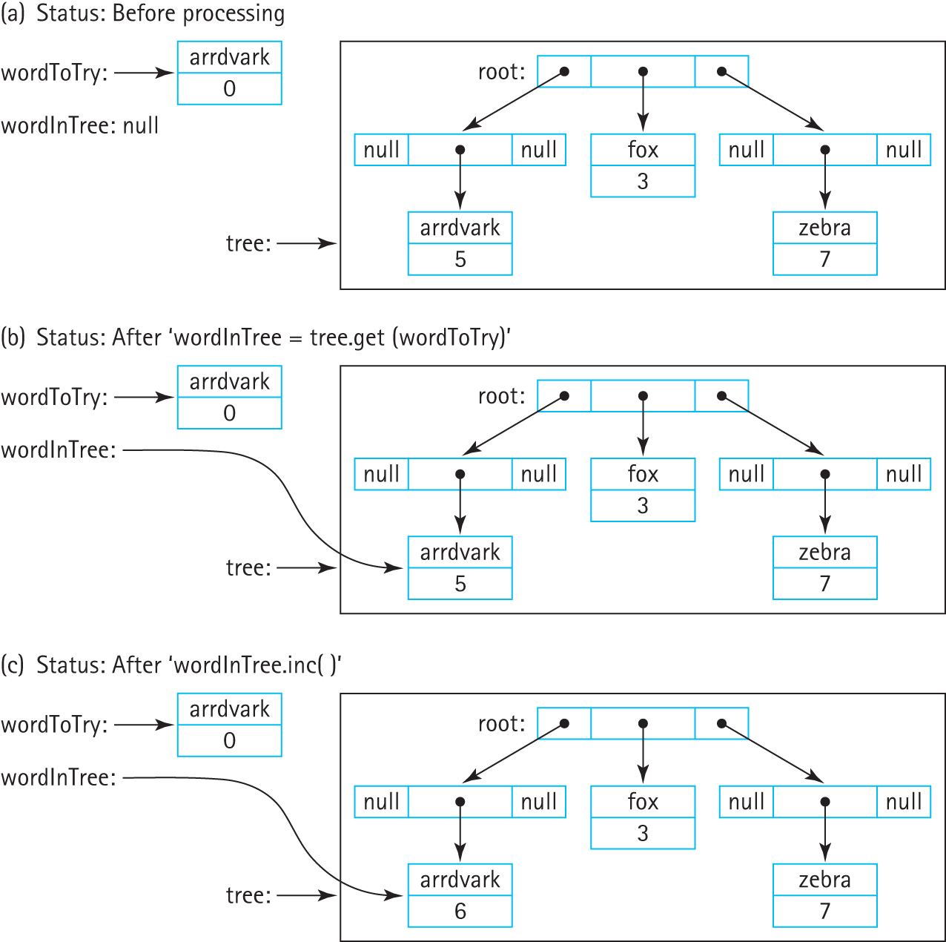
Processing a word

Slide 80
The Application
Instructors can now review the code and demonstrate/discuss the application.

Slide 81
7.10 Tree Variations
Trees can be binary, trinary (up to three children per node), n-ary (up to n children per node), alternating ary, balanced, not balanced, partially balanced, self-adjusting, and store information in their nodes or their edges or both.
The Java Library does not include a general tree structure and neither do most textbooks.
Often with trees we let the specific target application dictate the definition, assumptions, rules, and operations associated with a specific implementation.

Slide 82
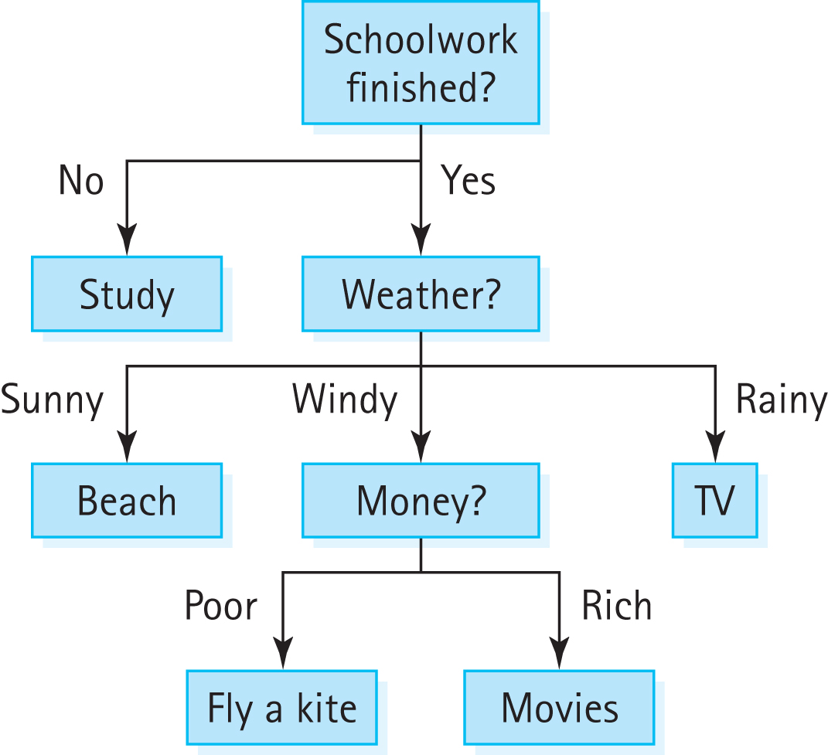
Application-Specific Variations
Decision Trees:

Slide 83
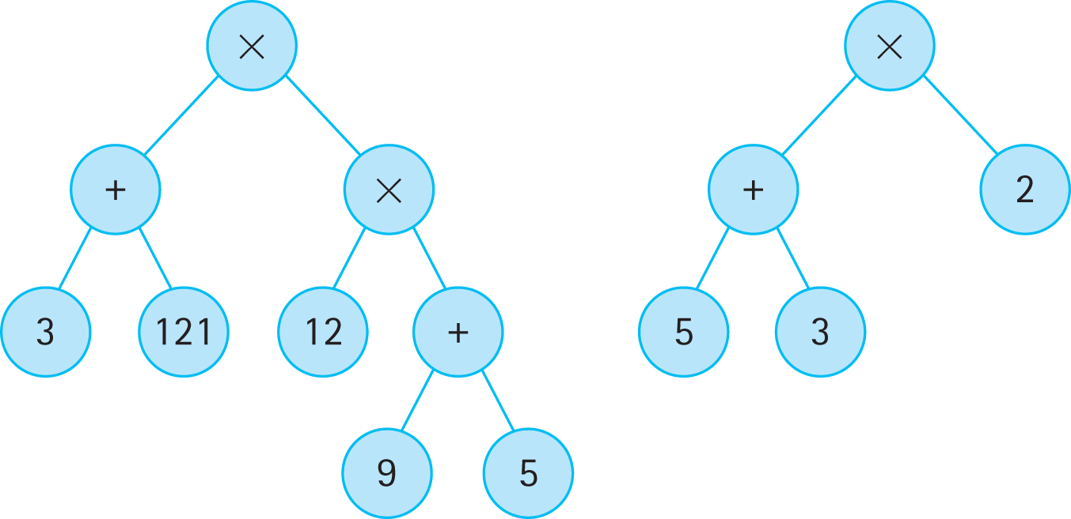
Application-Specific Variations
Expression/Parse Trees:

Slide 84
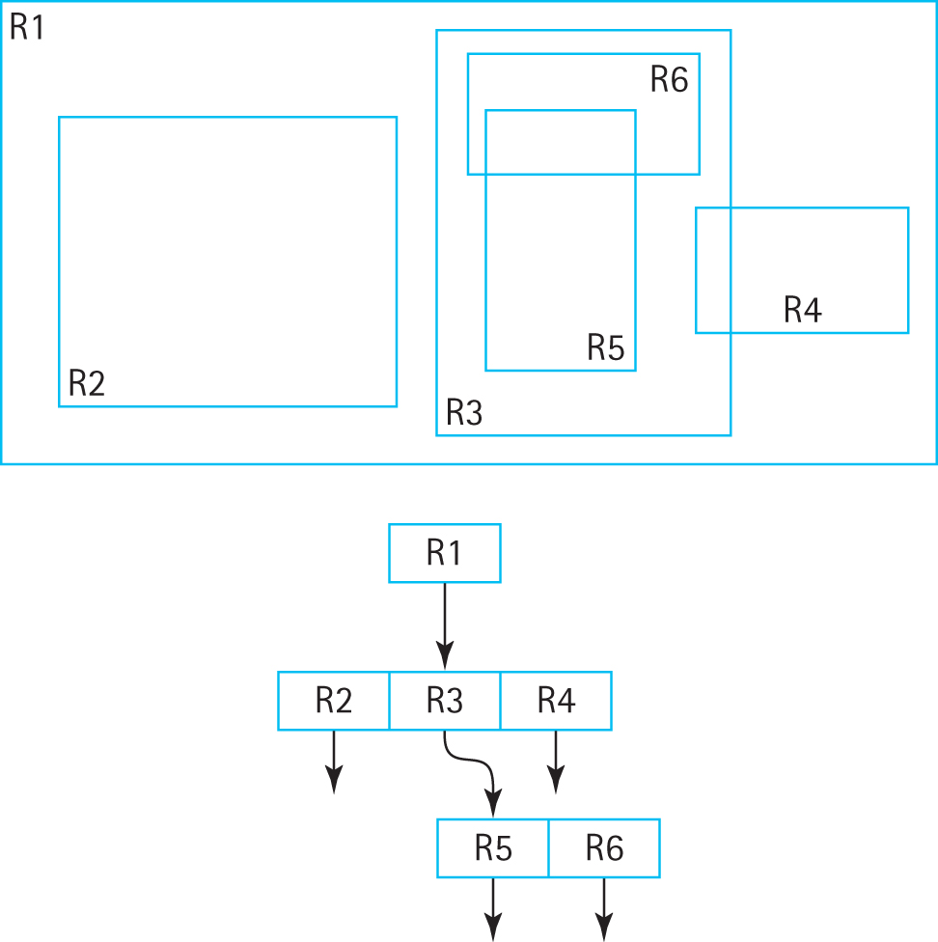
Application-Specific Variations
R Trees:

Slide 85
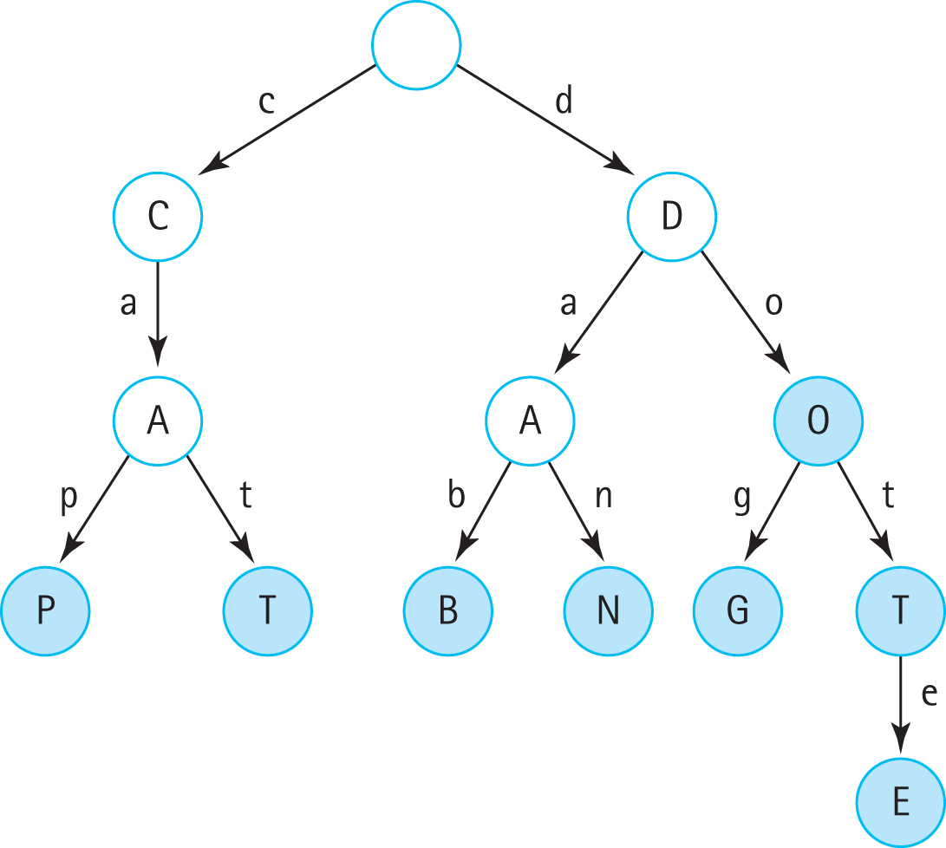
Application-Specific Variations
Tries/Prefix
Trees:

Slide 86
Balanced Search Trees
The Binary Search Tree ADT presented in this chapter is an excellent collection structure for holding “random” data, but suffers from one major weakness—it can become unbalanced.
Many search tree variations have been invented to address this weakness, each in turn with their own strengths and weaknesses.

Slide 87
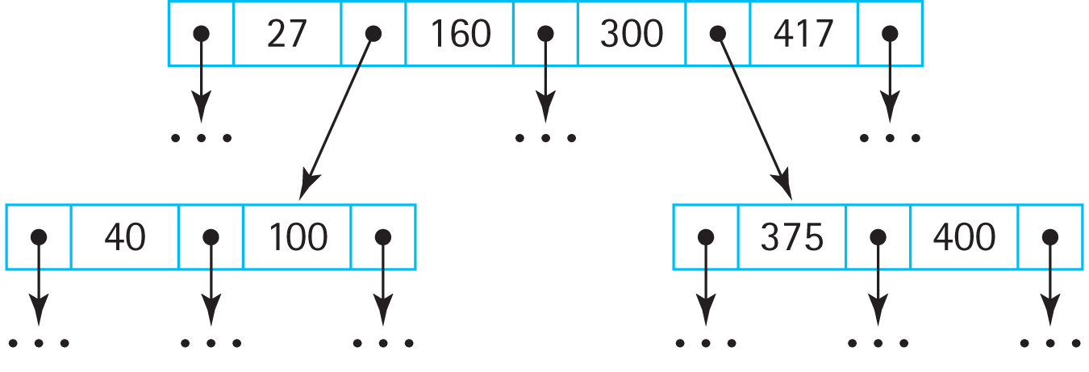
Balanced Search Trees
B-Trees: a search tree that allows internal nodes to hold multiple values and have multiple children

Slide 88
Balanced Search Trees
B-Tree Variants: A popular variant of the B-Tree is the 2-3-4 tree, where nodes are constrained to hold 1, 2, or 3 values and therefore have 2, 3, or 4 subtrees (thus the name of the tree)
Searching, insertion, and removal of information is always O(log₂N) and the amount of work required to process the information within any node is constant.

Slide 89
Balanced Search Trees
A 2-3-4 tree can be implemented using a binary tree structure called a red-black tree. In this structure nodes are “colored” either red or black (each node must hold an extra boolean value that indicates this information). The color of a node indicates how its value fits into the corresponding 2-3-4 tree.
The Java Library includes two important classes that use tree implementations. The Java TreeMap class supports maps (see Chapter 8) and the Java TreeSet class supports sets (see Section 5.7, “Collection Variations”). In both cases the internal representation is a red-black tree.

Slide 90
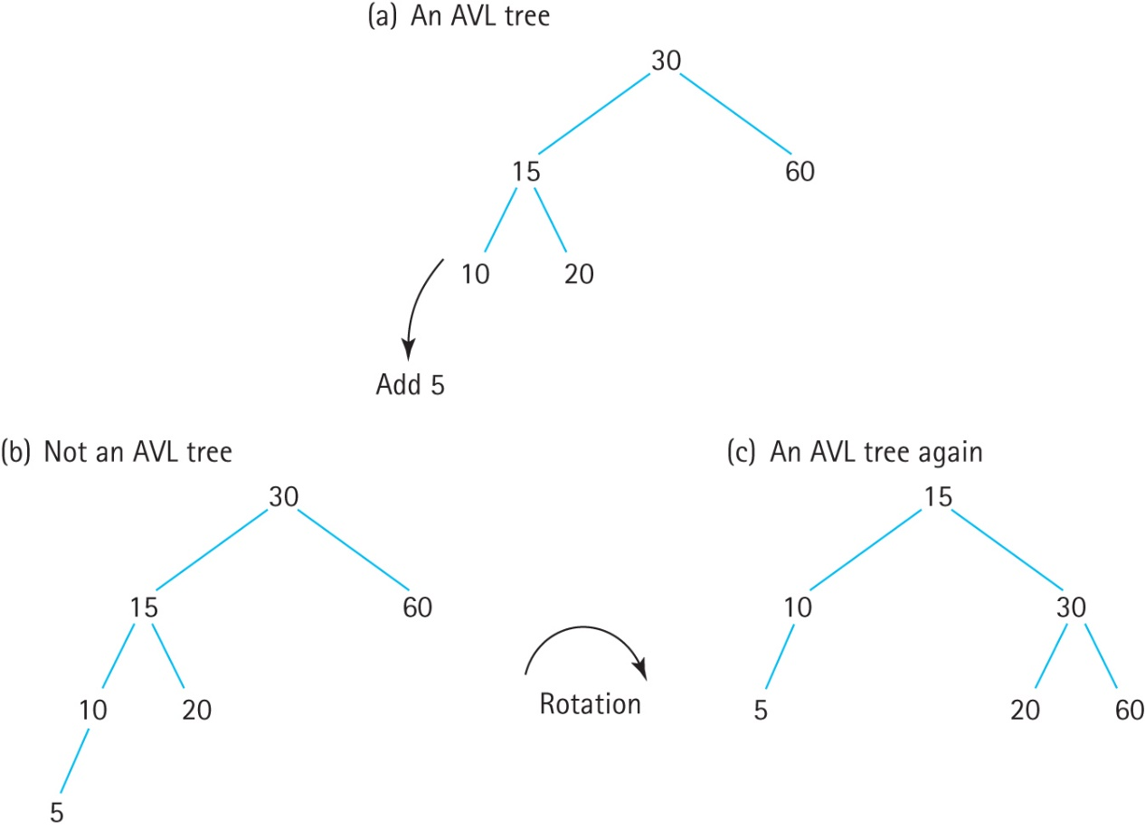
Balanced Search Trees
AVL Trees: the difference in height between a node’s two subtrees can be at most 1.
During addition and removal of nodes extra work is required to ensure the tree remains balanced.

